Slide 1
SaaS Monitoring and Security Powered by

Slide 2
Amateurs hack systems,
professionals hack people.
-Bruce Schneier
Author and Cryptographer
Notes:
Data VS Goliath

Slide 3
By The Numbers
61% of breaches are identity driven
21,382 business email compromise (BEC) cases – $2.7B lost (2022)
84% of businesses have experienced BEC
BEC is 64x more profitable than ransomware https://www.ic3.gov/Media/PDF/AnnualReport/2022_IC3Report.pdf https://www.egress.com/blog/security-and-email-security/which-cyberthreats-are-microsoft-365-users-most-at-risk-of
Notes:
65% increase in global exposed losses between July 2019 and December 2021

Slide 4
Microsoft’s Response
Member Account, Password, and Security
…You agree to notify Microsoft immediately of any unauthorized use of your account or any other breach of security. Microsoft will not be liable for any loss that you may incur as a result of someone else using your password or account, either with or without your knowledge. However, you could be held liable for losses incurred by Microsoft or another party due to someone else using your account or password…
https://www.microsoft.com/en-us/legal/terms-of-use

Slide 5
WHAT YOU DON’T KNOW CAN HURT YOU…

Slide 6
Size Doesn’t Matter
If you have customers, incoming revenue, and a bank account, then you are a target
Hackers don’t care how big or small you are
Oftentimes you won’t know a breach happened until it’s too late
All it takes is a singe person clicking on an email (even by mistake)

Slide 7
The Cost of a Breach
Business interruptions
Legal issues
Financial losses
Regulatory involvement
HR implications
Public relations crises

Slide 8
How We Can Help
Monitoring of your SaaS business applications for suspicious activity
Account logins, failed logins, unapproved logins, logins from unapproved locations, externally shared files, and more
Alerting capabilities to notify us of suspicious events in real-time
Automatic remediation of detected threats through customizable rules
Reporting tools for investigating security incidents and supporting audits
Notes:
Our industry (information assurance) has many different standards that define both best practices and required practices to demonstrate that security is adequate to protect information. Whether it’s NIST, CIS, ISO, COBIT, CMMC, HIPAA, PCI etc… SaaS Alerts provides proof of real time monitoring for IAM events, Data Exfiltration, Policy and Configuration changes and account behavior analysis. In addition SaaS alerts provides configuration management and automated response to secure compromised accounts.Upon request SaaS Alerts provides its partners with detailed event and alert mapping to specific NIST controls on a per application basis.

Slide 9
Additional Features
Stale Account Cleanup

Slide 10
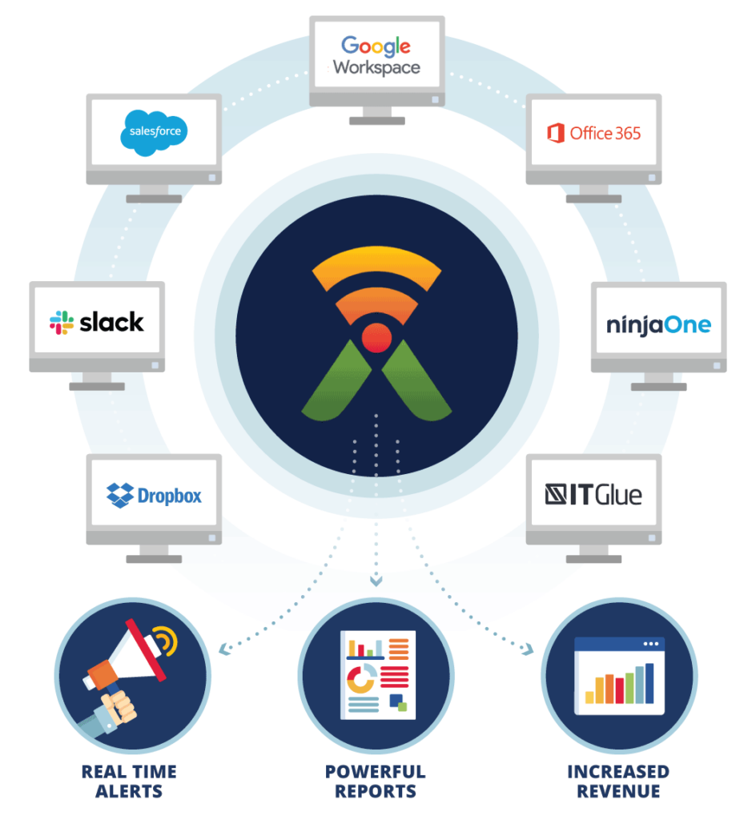
We Protect All These Tools

Slide 11
Next Steps
We’d like to:
Run a complimentary SaaS Cybersecurity Assessment on your environment
Deliver a full report on what’s happening behind the scenes of your SaaS applications
Provide a comprehensive proposal on how we can help

Slide 12
Thank You!

